Slide 1
DMA CONTROLLER
DMA (Direct Memory Access) > Direct memory access is an I/O technique commonly used for high speed data transfer. > In DMA, the MPU releases the control of the buses to a device called DMA controller. > The controller manages the data transfer between memory and peripherals under its control, thus bypassing the MPU. > For all practical purposes, DMA controller is a processor capable of copying data at high speed from one location to another location. THE 8237 DMA CONTROLLER > The 8237 is a programmable DMA controller used as a peripheral interface circuit for microprocessor system. > It is designed to improve system performance by allowing external devices to directly transfer information to or from system memory. Memory to memory transfer capability is also improved. > It has four independent channels with each channel capable of transferring 64K bytes. > The 8237 is designed to be used in conjunction with external 8-bit address register such as 8282.
> 8237 is a complex device. We can study its properties under two sections: DMA Channels and DMA Signals.

Slide 2
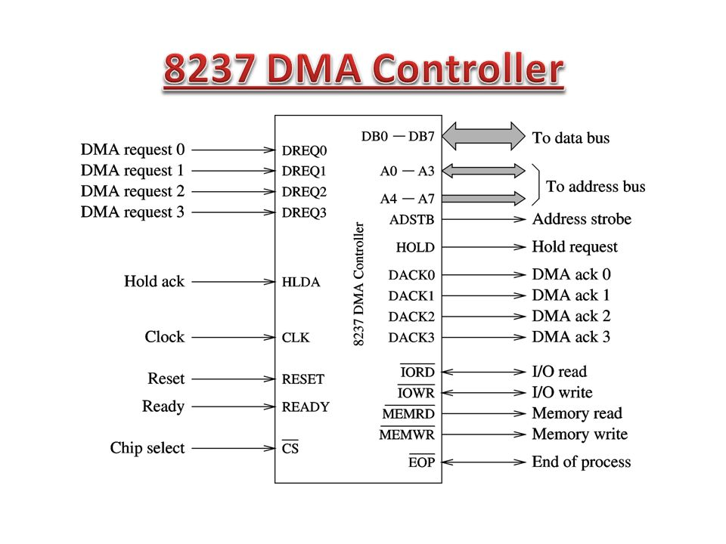

Slide 3
1. DMA CHANNELS > 8237 has four DMA Channels: CH0 to CH3 > Two 16-bit registers are associated with each channel. > Memory Address Register: used to load starting address of byte to be copied. > Count Register: used to load the count of number of bytes to be copied. > The address of these register are determined by four address lines A3 to A0 and so on.

Slide 4
2. DMA SIGNALS DMA signals can be divided into two groups: i) Signals required to interface with peripheral devices ii) Signals required to interface with MPU i) Signals required to interface with peripheral devices: DREQ0-DREQ3 (DMA Request) > These are four independent, asynchronous input signals to the DMA channels from peripheral devices. > To obtain DMA service, a request is generated by activating the DREQ line of the channel. DACK0-DACK3 (DMA Acknowledgment) > These are output lines to inform the individual peripherals that a DMA request is granted. ii) Signals required to interface with MPU: AEN (Address Enable) and ADSTB (Address Strobe) > These are active high output signals that are used to latch a high order address byte from data lines to generate 16-bit address. MEMR(Memory Read) and MEMW(Memory Write) > These are output signals used during the DMA cycle to write and read from memory. A3-A0 Address Lines > These are bidirectional address lines. > They are used to access various internal registers. HRQ (Hold Request) and HLDA (Hold Acknowledgment) > HRQ is an output signal used to request MPU to receive control of the system bus. > After receiving the HRQ, the MPU completes the bus cycle and issues the HLDA signal.

Slide 5
DMA OPERATION
The 8237 is designated to operate in two major cycles. These are called Idle and Active cycle. Idle Cycle: When no channel is requesting service, the 8237 will enter the idle cycle. In this cycle the 8237 will sample DREQ lines every clock cycle to determine if any channel is requesting DMA service. The device will also sample CS, looking for an attempt by MPU to write or read the internal register of 8237. When CS is low and HRQ is low, the 8237 enters the program condition. Special software commands can be executed by 8237 in program condition. Active Cycle: When the 8237 is in the idle cycle and channel requests a DMA service, the device will output an HRQ to the microprocessor and enter into the active cycle. In this cycle the DMA transfer occurs in one of the four modes: 1) Single Transfer Mode 2) Block transfer Mode 3) Demand Transfer Mode 4) Cascade Mode 1. Single Transfer Mode In this mode, the device is programmed to make one transfer only. The word count will be decremented and the address decremented or incremented following each transfer. 2. Block Transfer Mode In this mode the device is activated by DREQ to continue making transfer during the service until Terminal Count (TC), caused by word count going to zero or an external End of Process (EOP) is encountered.

Slide 6
3. Demand Transfer Mode In demand transfer mode the device is programmed to continue making transfer until a TC or external EOP is encountered or until DREQ line goes inactive. Thus transfer may continue until the I/O device has exhausted its data capacity. After the I/O device has had a chance to catch up, the DMA service is re-established by means of a DREQ. 4. Cascade Mode This mode is used to cascade more than one 8237 together for simple system expansion. The HRQ and HLDA signals from the additional 8237 are connected to the DREQ and DACK signals of a channel of the initial 8237.

Slide 7
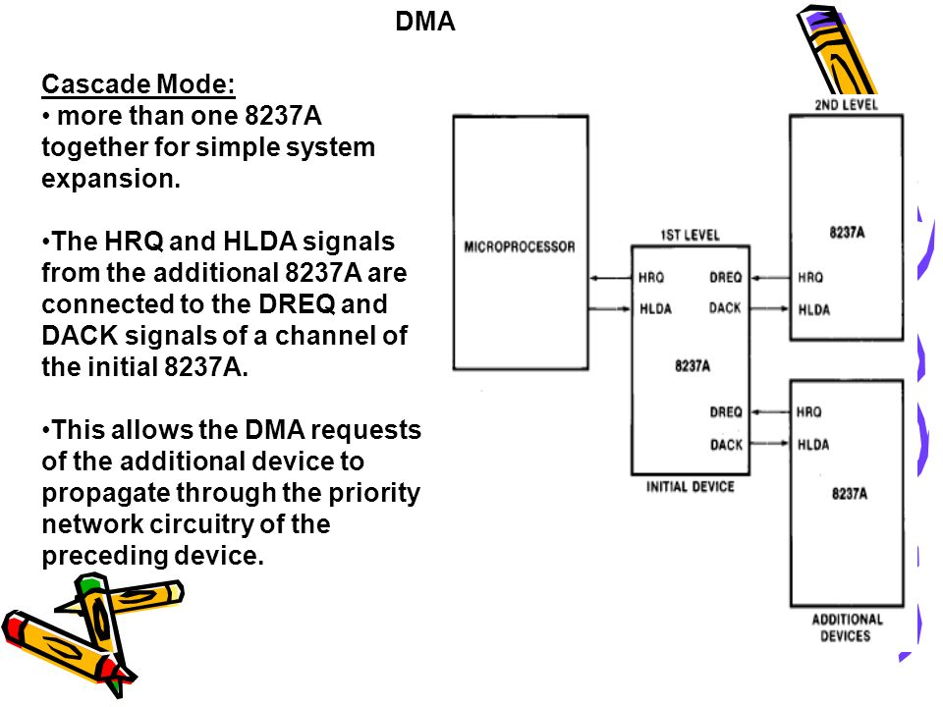

Slide 8
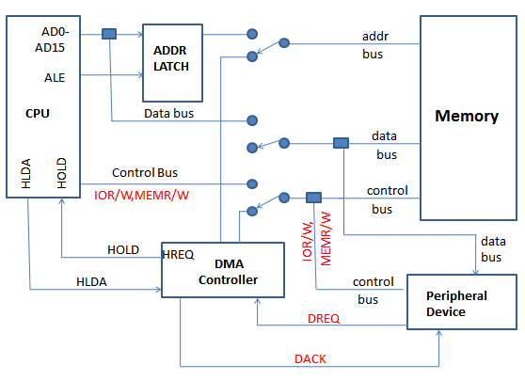
DMA TRANSFER

Slide 9
The sequence of DMA transfer is as follows: 1. The I/O devices request the DMA controller to perform DMA transfer through DREQ (DMA request) line. 2. The DMA controller in turn sends a request signal (HRQ) to MPU through the HOLD line. 3. The MPU finishes the current machine cycle and releases the system bus. It also acknowledges the receiving of HOLD signal through HLDA line. 4. The DMA controller acquires control of the system bus. The DMA controller sends the DACK signal to the peripheral I/O and the DMA transfer begins. 5. At the end of the transfer, the system bus is released by the DMA controller. The MPU takes control of the system bus and continues the operation.

Slide 10
8251A UNIVERSAL SYNCHRONOUS ASYNCHRONOUS RECEIVER TRANSMITTER (USART)
The 8251A is a USART (Universal Synchronous Asynchronous Receiver Transmitter) for serial data communication. As a peripheral device of a microcomputer system, the 8251A receives parallel data from the CPU and transmits serial data after conversion. This device also receives serial data from the outside and transmits parallel data to the CPU after conversion.

Slide 11
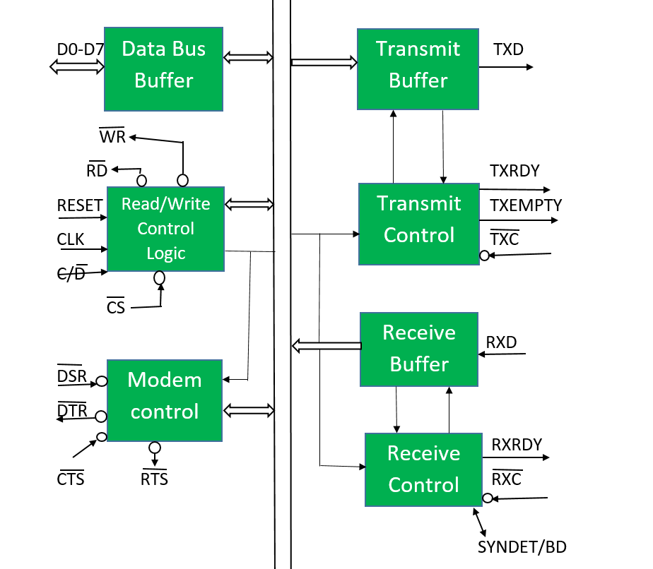

Slide 12
Data Bus Buffer This 3-state bidirectional, 8-bit buffer is used to interface 8251A to the system data bus. Date is transmitted or received by the buffer upon execution of Input/Output instruction of CPU. Read/Write Control Logic This block contains following signals- > RESET: A "High" on this input forces the 8251A into "reset status." The device waits for the writing of "mode instruction." > CLK(Clock): CLK signal is used to generate internal device timing. > WR(Write): This is the "active low" input terminal which receives a signal for writing transmit data and control words from the CPU into the 8251A. > RD(Read): This is the "active low" input terminal which receives a signal for reading receive data and status words from the 8251A. > C/D (Command/Data): This is an input terminal which receives a signal for selecting data or command words and status words when the 8251A is accessed by the CPU. If C/D = 0, data will be accessed. If C/D = 1, command word or status word will be accessed. > CS (Chip Select): This is the "active low" input terminal which selects the 8251A at low level when the CPU accesses.

Slide 13
Modem Control The 8251A has the set of control inputs and outputs that can be used to simply interface to almost any modem. This block has following signals- > DSR (Data Set Ready): This is an input port for MODEM interface. The input status of the terminal can be recognized by the CPU reading status words. > DTR (Data Terminal Ready): This is an output port for MODEM interface. It is possible to set the status of DTR by a command. > CTS (Clear to Send): This is an input terminal for MODEM interface which is used for controlling a transmit circuit. The terminal controls data transmission if the device is set in "TX Enable" status by a command. Data is transmittable if the terminal is at low level. > RTS (Request to Send): This is an output port for MODEM interface. It is possible to set the status RTS by a command. Transmit Buffer The Transmit Buffer accepts parallel data from the Data Bus Buffer, converts it to serial bit stream, inserts the appropriate character or bits and outputs a serial stream of data on the TXD output pin.

Slide 14
Transmit Control The Transmit Control manages all the activities associated with the transmission of serial data. It has following signals- > TXRDY (Transmitter Ready): This is an output terminal which indicates that the transmitter is ready to accept a data character. > TXE(Transmitter Empty): This is an output terminal which indicates that the 8251A has transmitted all the characters and had no data character. > TXC (Transmitter Clock): The Transmitter Clock controls the rate at which the character is to be transmitted. Receive Buffer The Receive Buffer accepts serial data, converts this serial data to parallel format and sends to the CPU. Serial Data is input to RXD pin. Receive Control This functional block manages all receiver-related activities and consists of following signals- > RXRDY (Receiver Ready): This is a terminal which indicates that the 8251A contains a character that is ready to ready by CPU. > RXC (Receiver Clock): This is a clock input signal which determines the transfer speed of received data. > SYNDET/BD (SYNC detect/ Break Detect): This pin is used in Synchronous Mode for SYNDET and may be used as either input or output and is programmable through the Control Word. In Asynchronous mode it can be used for BD which goes HIGH whenever the receiver remains low through two consecutive stop bits.

Slide 15
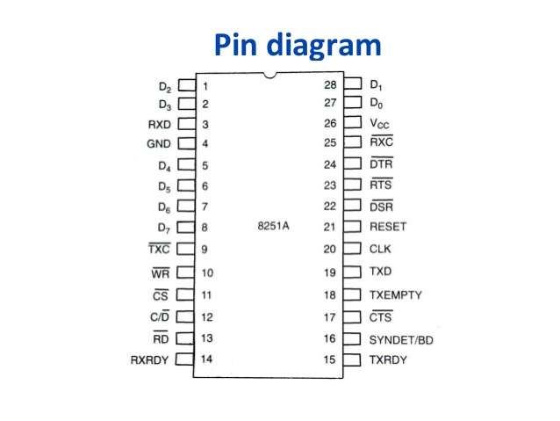
PIN DIAGRAM(8251A )

Slide 16
CONTROL WORDS
There are two types of control word. 1. Mode instruction 2. Command 1) Mode Instruction The bit configuration of mode instruction is shown in Figures 2 and 3. In the case of synchronous mode, it is necessary to write one-or two byte sync characters. If sync characters were written, a function will be set because the writing of sync characters constitutes part of mode instruction.

Slide 17
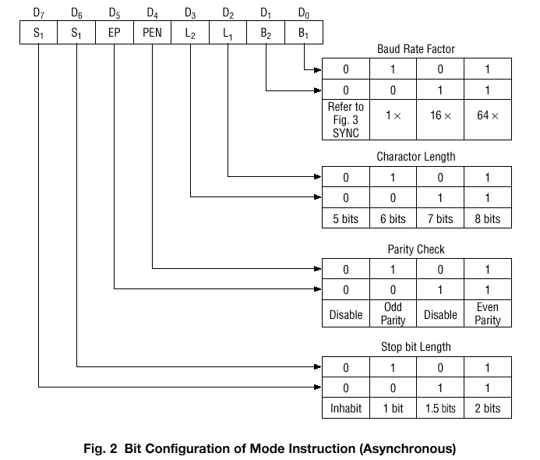

Slide 18
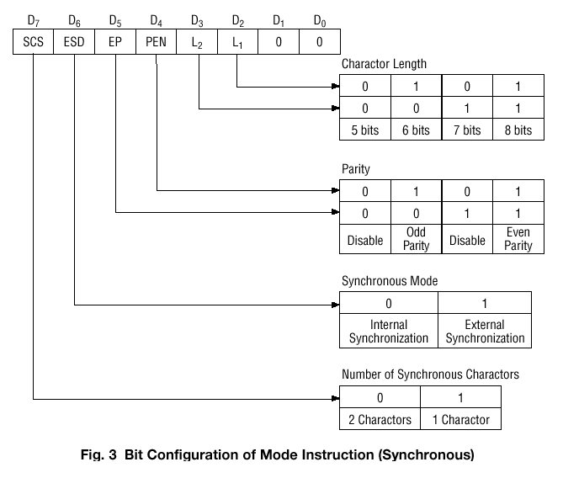

Slide 19
2) Command
Command is used for setting the operation of the 8251. It is possible to write a command whenever necessary after writing a mode instruction and sync characters.
Items to be set by command are as follows:
• Transmit Enable/Disable
• Receive Enable/Disable
• DTR, RTS Output of data.
• Resetting of error flag.
• Sending to break characters
• Internal resetting
• Hunt mode (synchronous mode)

Slide 20
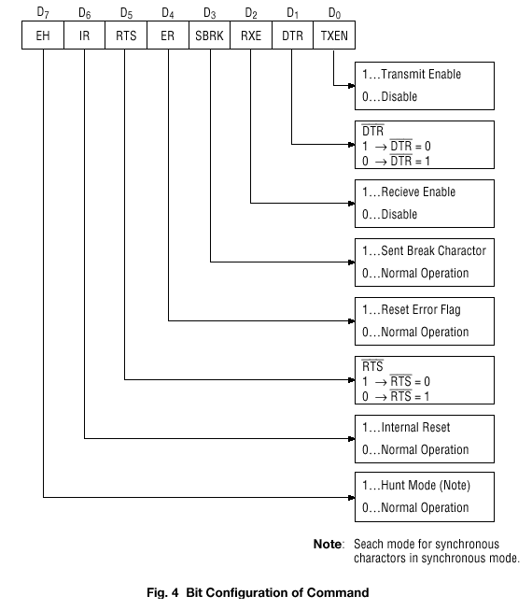

Slide 21
Status Word
It is possible to see the internal status of the 8251 by reading a status word. The bit configuration of status word is shown in Fig. 5.

Slide 22
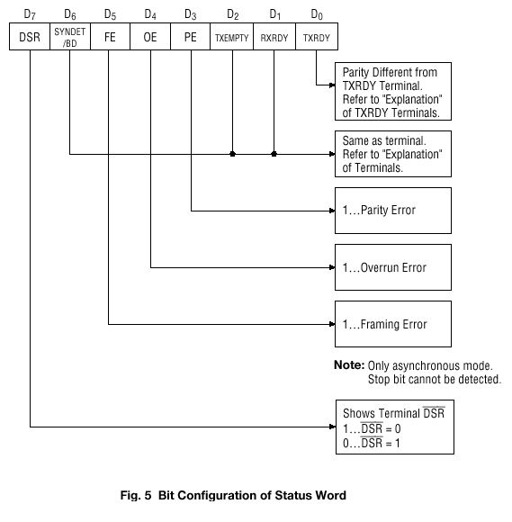

Slide 23
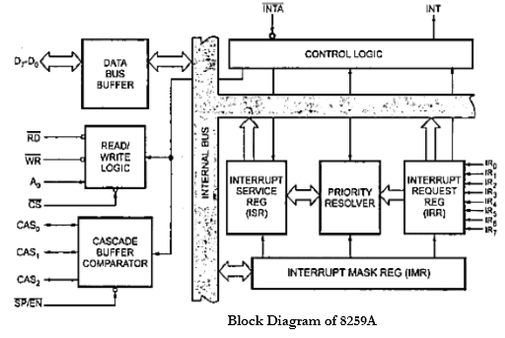
8259A PROGRAMMABLE INTERRUPT CONTROLLER (PIC) gram

Slide 24
Data Bus Buffer > This tri-state, bidirectional 8-bit buffer is used to interface 8259A with the system data bus. > Control words and status information are transferred through data bus buffer. Read/Write Control Logic > The function of this block is to accept commands from CPU and control the device. > It contains the initialization command word register (ICW) and operational command word register (OCW) to store various control formats for device operation. > It has the following control signals- CS(Chip Select): A low on this input enables the 8259A. WR(Write): A low on this input enables the CPU to write control words to 8259A. RD(Read): A low on this input enables 8259A to send its status to the CPU. A0: This line is connected to address line A0 of CPU. It is used to select various command registers. INT (Interrupt): This pin is directly connected to INTR of MPU. This pin goes high whenever a valid interrupt request occurs. It is used to interrupt CPU. INTA(Interrupt Acknowledgment): This pin is used to enable 8259A interrupt-vector data onto the data bus. This pin is connected to INTA of CPU. Status Registers a) Interrupt Request Register (IRR) > 8-bit register that indicates which interrupt request inputs are active b) In-Service Register (ISR) > 8-bit register that contains the level of interrupt being serviced c) Interrupt Mask Register (IMR) > 8-bit register that stores the interrupt mask bits and indicates which interrupts are masked off.

Slide 25
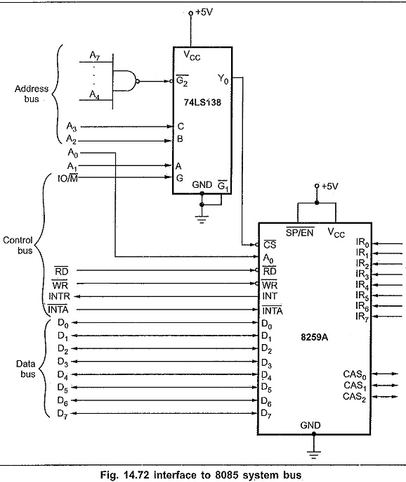
Priority Resolver > This block determines the priority of the bits set in IRR. Cascade Buffer > This block is used for cascading multiple 8259s to handle more than 8 interrupts. > CAS2-CAS0 cascade lines are used as output from master to slave 8259s. > SP/EN(Slave Program / Enable) pin is used to identify master or slave 8259A. For master SP/EN=1 and for slave SP/EN=0.

Slide 26
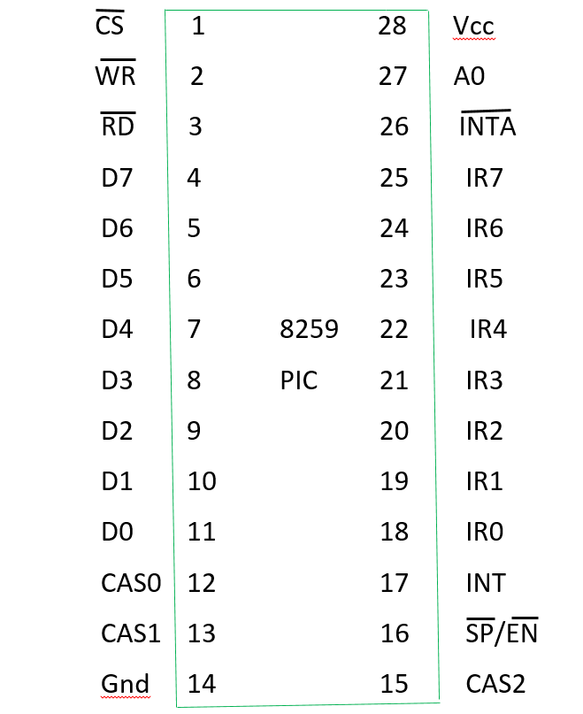
Pin diagram of 8259A

Slide 27
How can you handle 18 interrupts using 8259A PIC? > We can handle 18 interrupts using 8259A PIC by connecting three 8259As in cascade. Here, one 8259A is made master by connecting SP/EN pin to +5V and remaining two 8259As are made slave by connecting SP/EN pin to ground. > The INT pin of each slave is connected to interrupt request (IR) pin of the master 8259A. > The cascade buffer lines (CAS0-CAS2) of master 8259A must be connected to cascade buffer lines (CAS0-CAS2) of each slave. > The INT pin of master 8259A is connected to INTR pin of the microprocessor whereas the INTA pin of master 8259A is connected to INTA pin of microprocessor and the address line Ao of master 8259A is connected to address line Ao of the microprocessor.

Slide 28
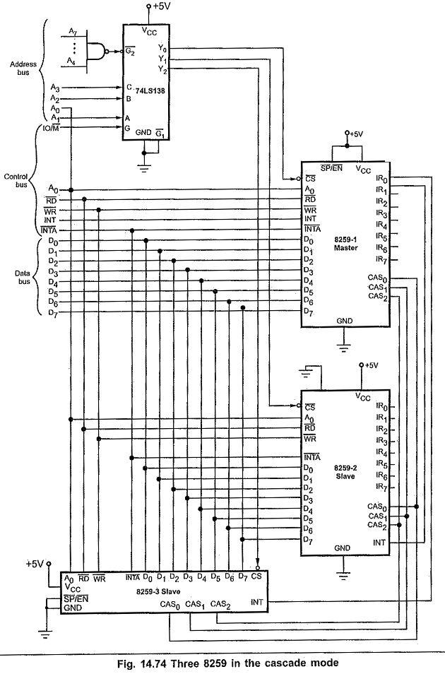

Slide 29
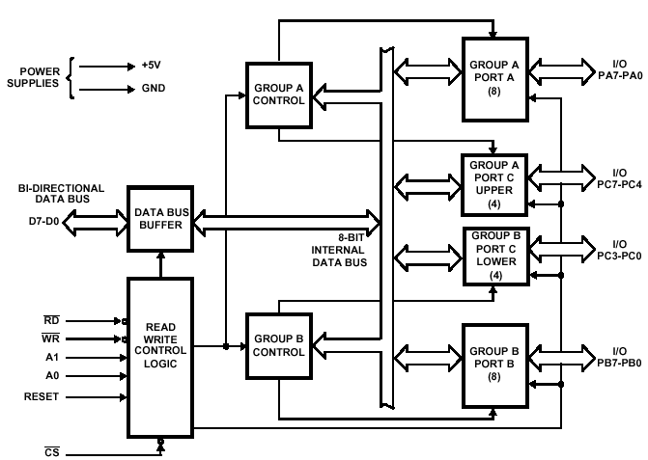
8255A PROGRAMMABLE PHERIPHERAL INTERFACE (PPI)

Slide 30
Figure shows the internal block diagram of 8255A. It consists of data bus buffer, control logic and Group A and Group B controls.
Data Bus Buffer: This tri-state bi-directional buffer is used to interface the internal data lilts of 8255 to the system data bus. Input or Output instructions executed by the CPU either Read date from or Write data into the buffer. Output data from the CPU to the ports or control register, and input data to the CPU from the ports or status register are all passed through the buffer.
Control Logic: The control logic block accepts control bus signals as well as inputs from the address bus, and issues commands to the individual group control blocks (Group A control and Group B control). It issues appropriate enabling signals to access the required data/control words or status word. The input pins for the control logic section are described here.
Group A and Group B Controls: Each of the Group A and Group B control blocks receives control words from the CPU and issues appropriate commands to the ports associated with it. The Group A control block controls Port A and PC_7-PC_4 while the Group B control block controls Port B and PC_3-PC_0.
Port A: This has an 8-bit latched and buffered output and an 8-bit input latch. It can be programmed in three modes: mode 0, mode 1 and mode 2.
Port B: This has an 8-bit data I/O latch/ buffer and an 8-bit data input buffer. It can be programmed in mode 0 and mode 1.
Port C: This has one 8-bit unlatched input buffer and an 8-bit output latch/buffer. Port C can be spitted into two parts and each can be used as control signals for ports A and B in the handshake mode. It can be programmed for bit set/reset operation.

Slide 31
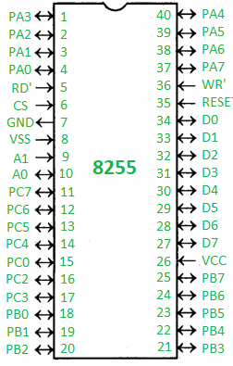
Pin DIAGRAM ( 8255A)

Slide 32
PA0 – PA7 – Pins of port A
PB0 – PB7 – Pins of port B
PC0 – PC7 – Pins of port C
D0 – D7 – Data pins for the transfer of data
RESET – Reset input
RD’ – Read input
WR’ – Write input
CS’ – Chip select
A1 and A0 – Address pins

Slide 33
To communicate with peripherals through 8255 three steps are necessary:
Determine the addresses of Port A, B, C and Control register according to Chip Select Logic and the Address lines A0 and A1.
Write a control word in control register.
Write I/O intructions to communicate with peripherals through port A, B, C.
The common applications of 8255 are:
Traffic light control
Generating square wave
Interfacing with DC motors and stepper motors

Slide 34
MODES OF OPERATION
8255A consists of two modes of operation. 1. I/O Mode (Input/Output Mode) 2. BSR Mode (Bit set/reset Mode) The BSR mode is used to set or reset the bits in Port C. The I/O mode is further divided into three modes: Mode 0, Mode 1 and Mode 2. Mode 0: Simple Input or Output Mode In this mode, ports A and B are used as two simple 8-bit I/O port and port C as two 4-bit ports. Each port can be programmed to function simply as input port or output port. The I/O features in Mode 0 are: > Output are latched > Inputs are not latched > Ports do not have handshake or interrupt capacity Mode 1: Input or Output with Handshake In this mode, handshake signals are exchanged between the MPU and peripherals during data transfer. The features of this mode are: > Two ports PA and PB function as 8-bit I/O ports. They can be configured either as input or output. > Each port PA and PB uses three lines from Port C as handshake signals. The remaining two lines of PC can be used for Simple I/O function (mode 0). > Input and Output data are latched. > Interrupt logic is supported. Mode 2: Bidirectional Data Transfer > This mode is used primarily in applications such as data transfers between two computers. > In this mode Port A can be configured as the bidirectional port (data bus) and Port B either in mode 0 or mode 1. > Port A uses five signals from Port C as handshake signals for data transfer. The remaining three signals form Port C can be used as Simple I/O or as handshake for Port B.

Slide 35
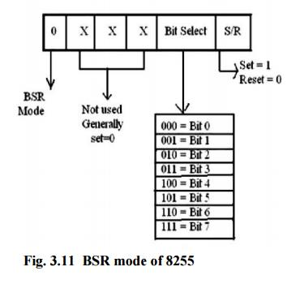
BSR Mode (Bit Set/Reset) > The BSR control word is only connected with 8-bits of Port C, which can be set or reset by writing appropriate control word in the control register. > I/O operations of port A and port B are not affected by a BSR control word. > In BSR mode, individual bits of port C can be used for applications such as ON/OFF switch.

Slide 36
Example: Generate BSR control words to set bit PC7 and PC3 and reset PC0 and PC2. Solution: Control Word to Set PC7= 00001111=0FH Control Word to Set PC3= 00000111= 07H Control Word to Reset PC0= 00000000= 00H Control Word to Reset PC2= 00000100=04H

Slide 37
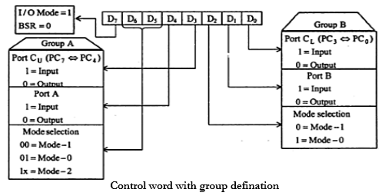

Slide 38
The control word format of the 8255 is shown in Fig. below. The contents of the control register are called the control word that specifies the input/ output functions of each port.
The control word register can be accessed to write the control word by selecting AD_1 and AD_0 in high condition i.e. both ON. This register is not available for read operation.
As indicated in Fig, the most significant bit (D_7) of the control word specifies either I/O function or the BIT set/ reset function.
With D_7= 1, the 8255 works in the I/O modes. Port-C operates in BIT SET/RESET (BSR) mode with D_7=0. The BSR Mode in no way affects the functioning of port-A and port-B.
Following steps are essential to communicate with the peripherals through the ports of the 8255
Determine address of ports-A, B, or C and of the control register according to the chip select logic and the address lines AD_1 and AD_0
Write the control word in the control word register.
Write input/output instructions in order to communicate with the peripherals through ports-A, B, and C of the 8255.

Slide 39
8254 Programmable interval timer (PIT)
8254 is a device designed to solve the timing control problems in a microprocessor.
It has 3 independent counters, each capable of handling clock inputs up to 10 MHz and size of each counter is 16 bit.
It operates in +5V regulated power supply and has 24 pin signals. All modes are software programmable.
The 8254 is an advanced version of 8253 which did not offered the feature of read back command

Slide 40
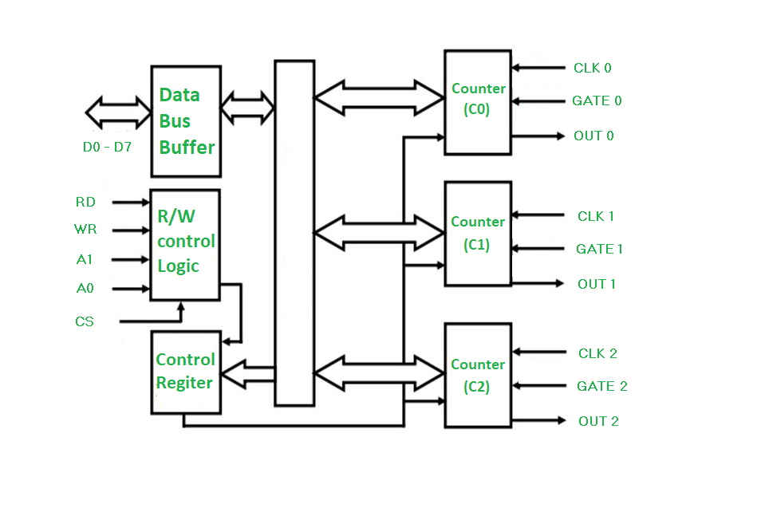
Block Diagram

Slide 41
Data Bus Buffer
> This tri-state bidirectional 8-bit buffer is used to connect 8254 PIT to the data bus of MPU.
Control Logic
> The control section has five signals: RD(Read), WR(Write), CS(Chip Select) and address lines AO, A1.
> RD(Read) and WR(Write) are connected to IOR(IO Read) and IOW(IO Write) respectively in IO mapped IO and RD(Read) and WR(Write) are connected to MEMR(Memory Read) and MEMW(Memory Write) respectively in Memory mapped IO.
> Address lines AO and A1 are connected to the address lines AO and A1 of MPU and CS is connected to the decoded address.
> CS is used to enable or select the device. If CS=0 the chip is selected.
> The counters and control word register are selected according to signals on lines AO and A1 as shown in table:

Slide 42
CS | A0 | A1 | SELECTION
0 | 0 | 0 | C0
0 | 0 | 1 | C1
0 | 1 | 0 | C2
0 | 1 | 1 | COUNTER REGISTER

Slide 43
Control Word Register
> This register is accessed when AO and A1 are at logic 1.
> It is used to write a command /control word which specifies the counter to be used, its mode and either read or write operation.
Counters
> 8254 includes three identical 16-bit counters that can operate independently in any six modes of operation.
> To operate a counter, a 16-bit count is loaded into its register.
> The counter can count either in BCD or Binary.

Slide 44
Applications
To generate accurate time delay
As an event counter
Square wave generator
Rate generator
Digital one shot

Slide 45
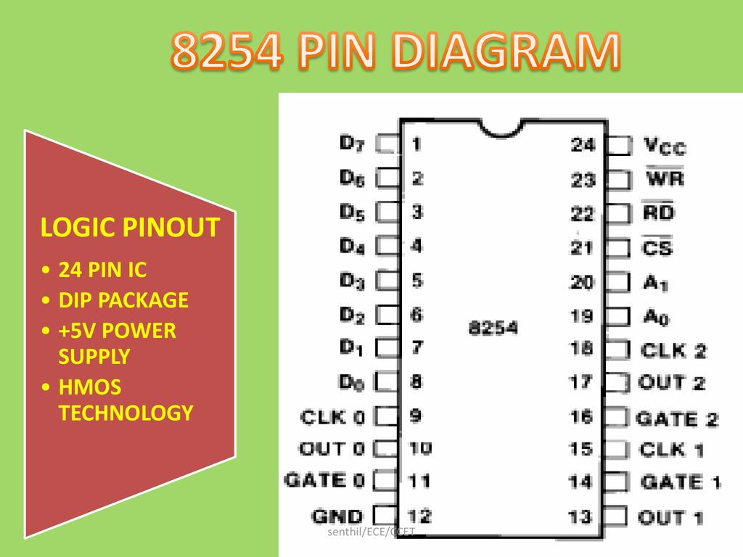

Slide 46
8254 Control Word and Operating modes
After power-up, the state of the 8254 is undefined.
The Mode, count value, and output of all Counters are undefined. How each counter operates is determined when it is programmed. Each counter must be programmed before it can be used.
Unused counters need not be programmed. Counters are programmed by writing a Control Word and then an initial count.

Slide 47
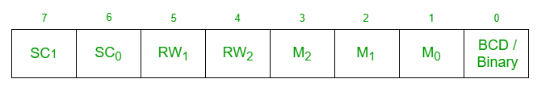
Control Word of 8254
The format of Control Word of 8254 is:
Here by using the value of SC1 and SC0 we select a specific counter:
SC1 | SC0 | SELECTION
0 | 0 | C0
0 | 1 | C1
1 | 0 | C2
1 | 1 | READ BACK STATUS

Slide 48
The values of RW1 and RW0 are used to decide the Read – Write operation
RW1 | RW0 | SELECTION
0 | 0 | Counter Latch Command
0 | 1 | Read/Write lower byte
1 | 0 | Read/Write higher byte
1 | 1 | Read/Write lower byte followed by higher byte

Slide 49
The values of M2, M1, M0 are used to decide the operating modes of 8254:
M2 | M1 | M0 | SELECTION
0 | 0 | 0 | MODE 0
0 | 0 | 1 | MODE 1
X | 1 | 0 | MODE 2
X | 1 | 1 | MODE 3
1 | 0 | 0 | MODE 4
1 | 0 | 1 | MODE 5

Slide 50
Example: Generate a 8254 control word to operate it as a BCD counter in mode 2 using counter 0 with 16 bit value of count.
Control word =
Control word = 00110101=35H
D7 | D6 | D5 | D4 | D3 | D2 | D1 | D0
0 | 0 | 1 | 1 | 0 | 1 | 0 | 1

Slide 51
MODES OF OPERATION
8254 can operate in six different modes of operation.
Mode 0: Interrupt on Terminal Count
> Initially OUT is low.
> Once count is loaded in the register, the counter is decremented every cycle and when the count reaches zero, the OUT goes high.
> The OUT remains high until a new count or command word is loaded.

Slide 52
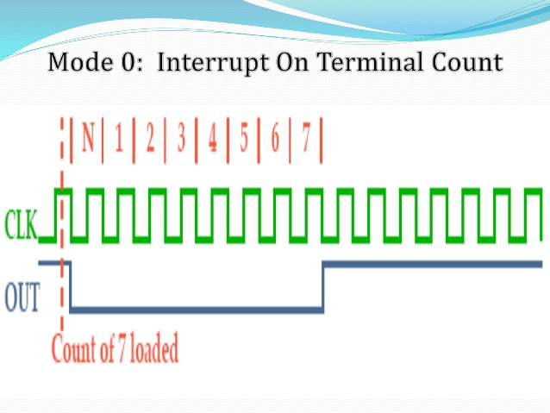

Slide 53
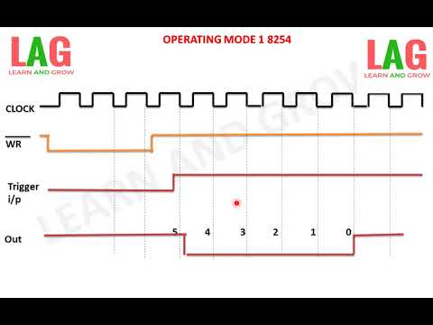
Mode 1: Hardware Retriggerable One-Shot
> OUT is initially high.
> When the GATE is triggered, the OUT goes low and at the end of count, the OUT goes high again thus generating a one-shot pulse.

Slide 54
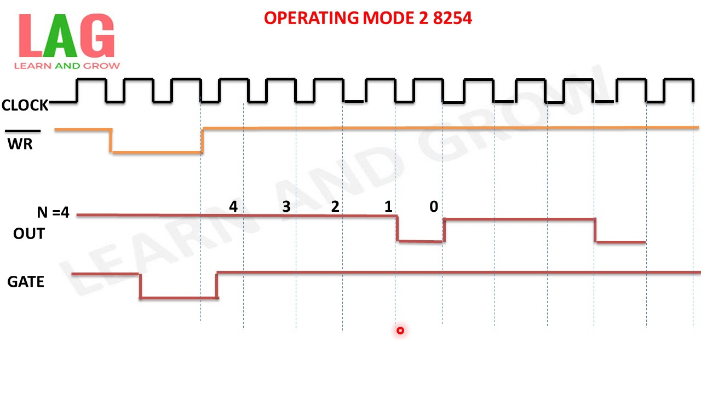
Mode 2: Rate Generator
> This mode is used to generate a pulse equal the clock period at a given interval.
> When count is loaded the OUT stays high until the count reaches 1 and then OUT goes low for one clock period.
> The count is reloaded automatically and the pulse is generated continuously

Slide 55
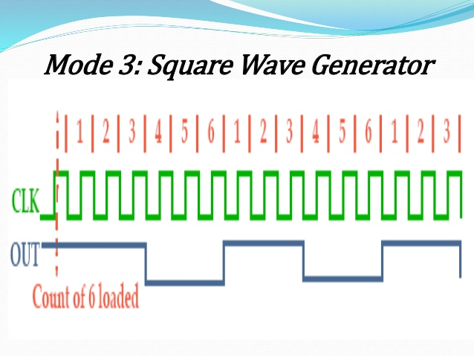
Mode 3: Square Wave Generator
> In this mode, when a count is loaded, the OUT goes high.
> The count is decremented by two every clock cycle and when it reaches zero OUT goes low and the count is reloaded again.
> This is repeated continuously, thus a square wave with period equal to the period of count is generated.
i.e frequency of square wave = (Frequency of Clock)/Count

Slide 56
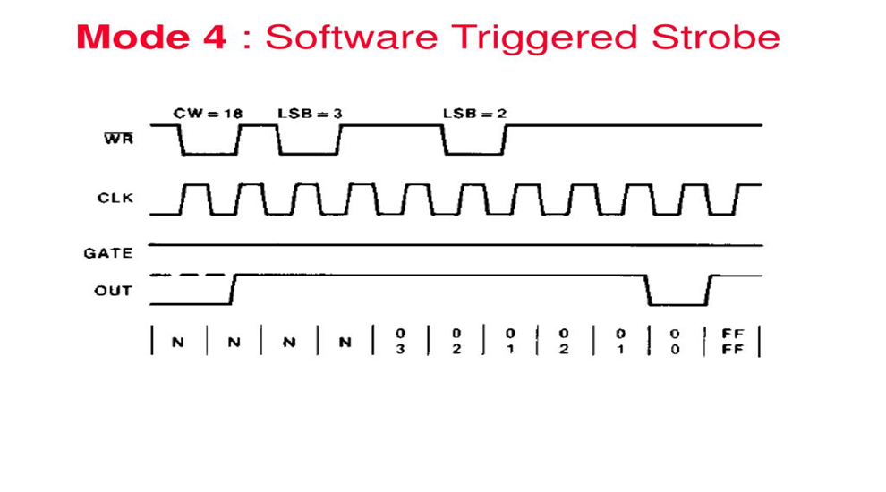
Mode 4: Software Triggered Strobe > In this mode, OUT is initially high. > OUT goes low for one clock period at the end of the count. > The count must be reloaded for subsequent outputs.

Slide 57
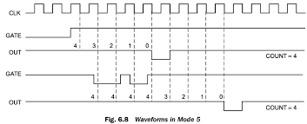
Mode 5: Hardware Triggered Strobe > This mode is similar to mode 4 except that it is triggered by the rising pulse at the GATE. > Initially OUT is high and when GATE pulse is triggered, the count begins. > At the end of the count, the OUT goes low for one clock cycle.

Slide 58
Assignments
1. Draw the block diagram of following devices and explain.
8255 PPI
8254 PIT
8259 PIC
8251 USART
8237 DMA Controller
2. How can you handle 18 interrupts using 8259 PIC. Explain.
3. What do you mean by DMA. Explain DMA transfer with the help of 8237 DMA Controller.
4. Explain various modes of operation of 8254 PIT.
5. Explain modes of operation of 8259 PIC.
6. Explain modes of operation of 8255 PPI.
7. Draw the format of control word of 8255 PPI and 8254 PIT.
8. Write a subroutine program to generate a square wave of 1KHz from the Counter-2 of 8254 PIT. Assume frequency of clock to be 10MHz.
9. Write 8086 ALP to take input from 8-switches connected to port A of 8255 PPI and display the status of the switches in 8 LEDs connected to port B of 8255 PPI. Assume the appropriate port address and draw the interfacing diagram.

